Slide 1

Hymon SARS-CoV-2 Test Kit

Slide 2
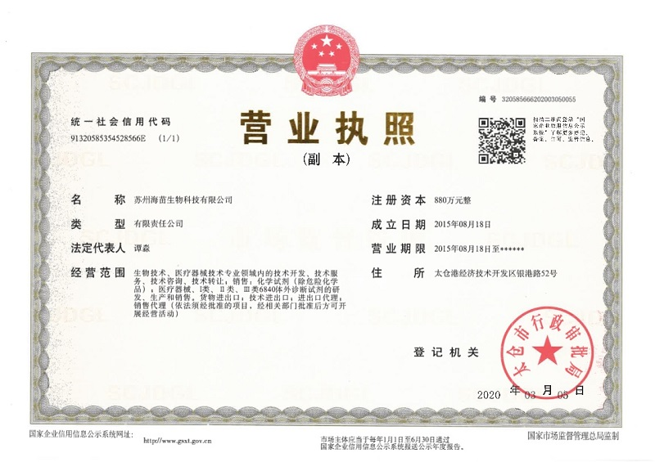
ⅠHymonBio Co., LTD
Incorporate on August 18th, 2015
Company Size: 30 employees
Founded by PhDs from University of Texas & Chinese Academy of Sciences
Focus on Precision Testing on cancer gene screening, epidemic pathogen DNA/RNA tests
* Business License

Slide 3
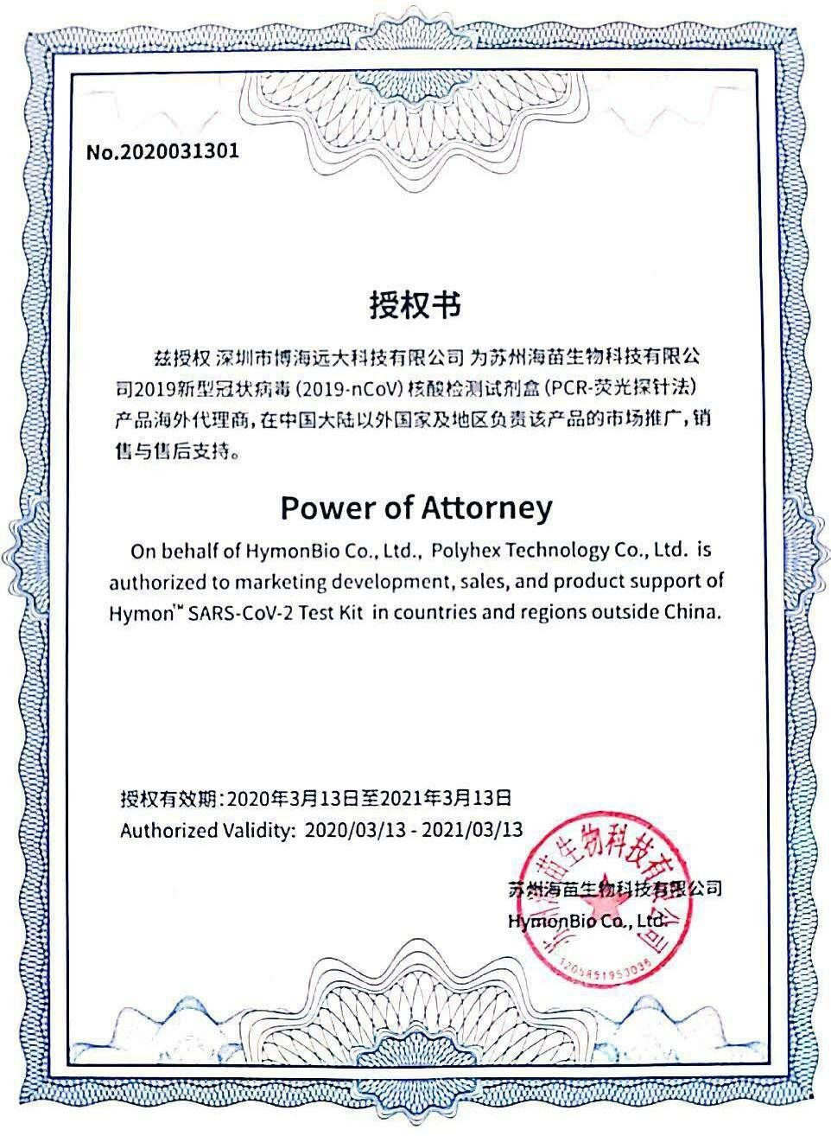
Power of Attorney
Polyhex Technology Co., Ltd. is authorized to marketing development, sales and product support of Hymon SARS-CoV-2 Test Kit overseas from March 13th, 2020 to March 13th, 2021.
* Power of Attorney

Slide 4
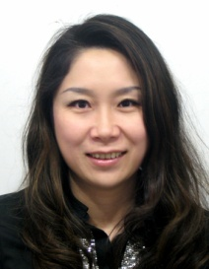
Founders:
PhD, Shanghai Institute of Life Sciences, Chinese Academy of Sciences; BS, Biochemistry, Nanjing University
Commissioner, Chinese Medical Laboratory Expert Committee
Principal Investigator, “Prevention and Control of Emerging Infectious Diseases”, the Mega Special Project of the 12th Five-Year Plan of the Ministry of Science and Technology
Award for Doctors of Entrepreneurship and Innovation, Jiangsu Province (2016)
Award of Suzhou GUSU Leadership Talent (2017)
First IVD certificate in China for H1N1 Test (2009)
First IVD certificate in China for H7N9 Test (2013)
Former executives in Kehua Bioengineering Co., LTD & Liferiver Co., LTD
More than 50 CFDA IVD registration certificates
Miao Tan
Founder/CEO

Slide 5
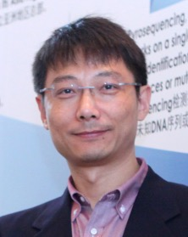
PhDr, University of Texas at Dallas
Commissioner, Chinese Medical Laboratory Expert Committee
Director, Biological Application and Transformation Experimental Center, Shenzhen Institute of Advanced Technology, Chinese Academy of Sciences
Professor, Industrialization, Medical School of Nantong University
Principal Investigators, National 973 Plan and 863 Plan projects, & “Special project for AIDS prevention and control”, the Mega Special Project of the 12th & 13th Five-Year Plan of the Ministry of Science and Technology
Former Director R&D Asia Pacific, Qiagen GmbH (Germany)
Former W.M. Keck Scholar, Pathology & Laboratory Medicine, University of Texas Health Science Center Houston
China’s first IVD certificate in nucleic acid blood screening test (2010)
More than 30 CFDA IVD registration certificates
Hua Tsen
Founder/CTO

Slide 6
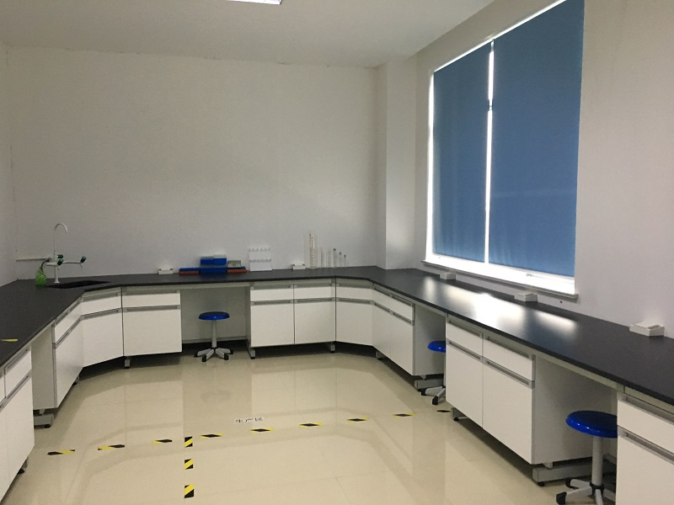
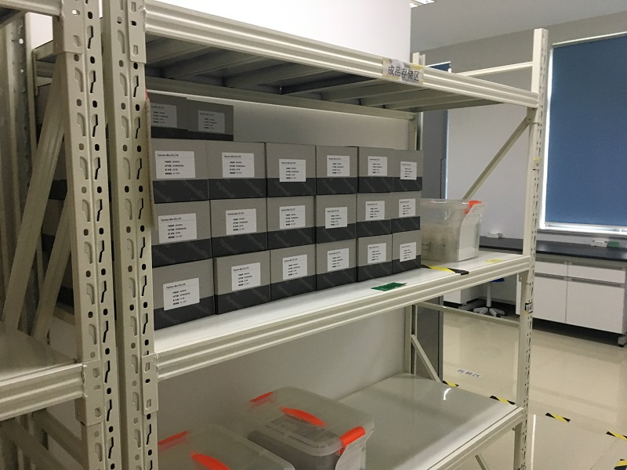
Experiment and Storage Environment:

Slide 7
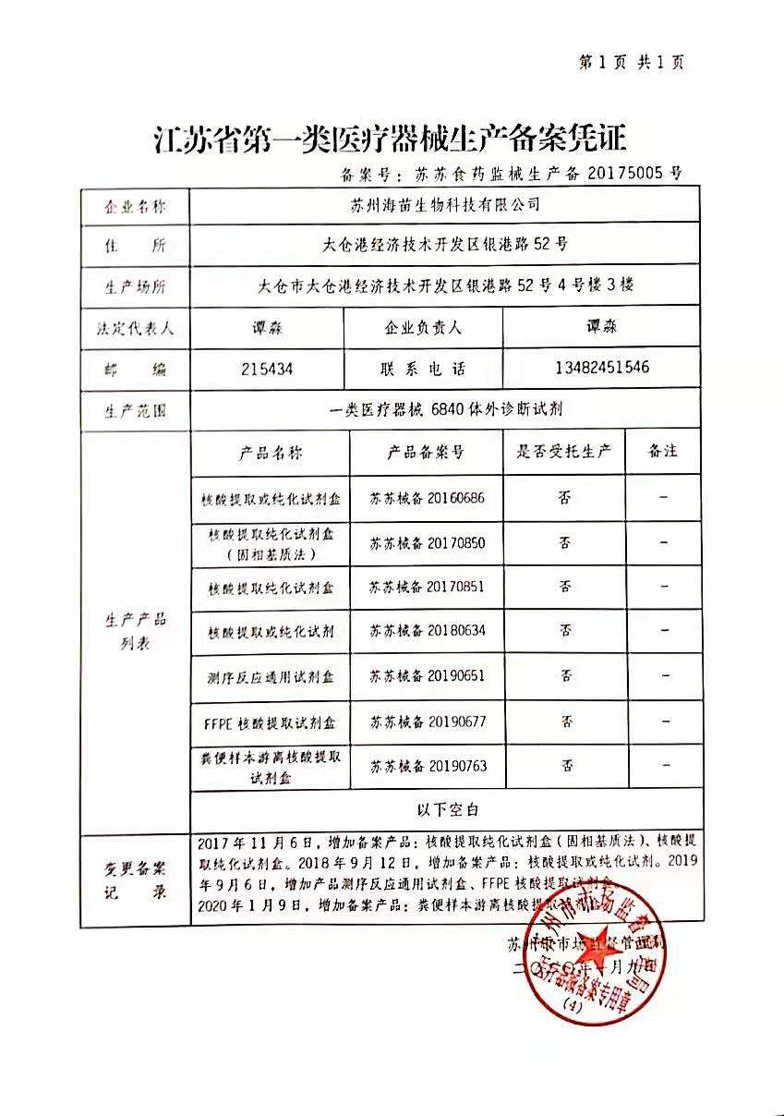
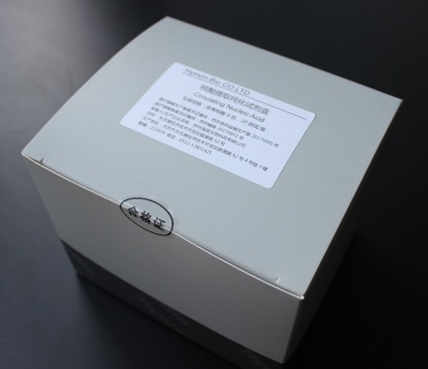
Introduction to Products:
7 certified GMP IVD kits
Nucleic acid extraction kits
Methylation conversion kits
Sequencing kit

Slide 8
6 authorized patents, 20 patents filing
Patent No | Patent name | Types | Legal Status
201610964037.5 | A method for quantitative detection of a compound by strip and lateral immunochromatography | Patent for Invention | Authorized
201611230329.2 | The invention relates to a nanometer multidirectional chromatography nucleic acid extraction solid phase medium and a preparation method | Patent for Invention | Authorized
2018207488132 | A biological gene culture device | Patent for Utility Models | Authorized
2018207923232 | Carrying plate and gene sequencing device | Patent for Utility Models | Authorized
2018208306659 | Carrier turntable structure | Patent for Utility Models | Authorized
2018208536294 | Gene sequencing unit | Patent for Utility Models | Authorized

Slide 9
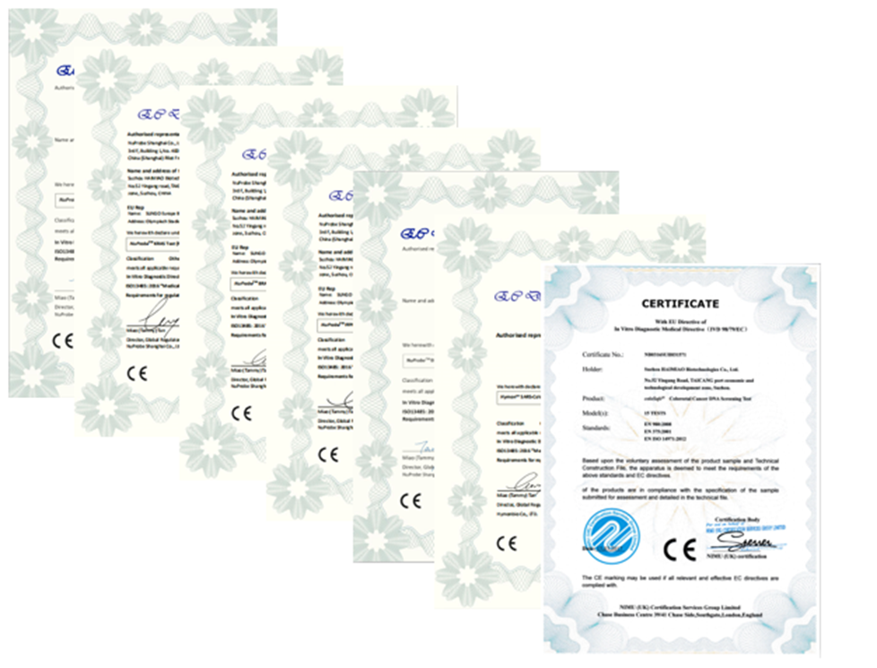
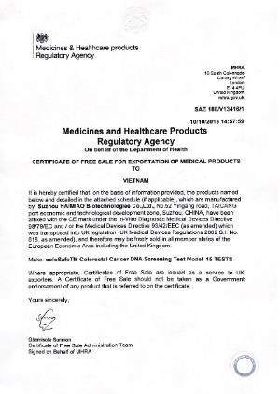
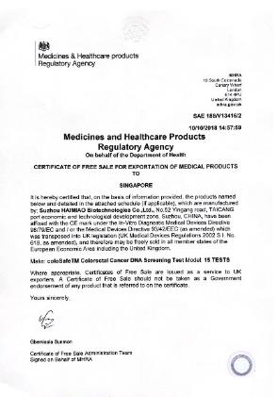
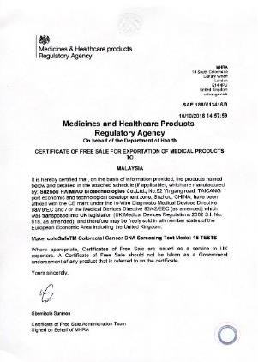
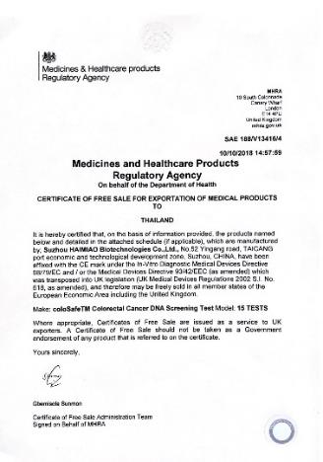
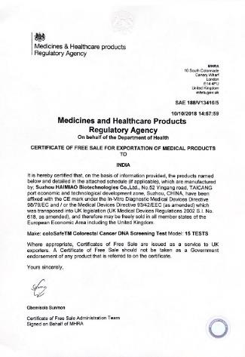
Six products have obtained European Union qualification certification（CE）
Colorectal cancer test has received free sale certificate in five countries
Vietnam
Singapore
Malaysia
Thailand
India

Slide 10
Kit series 1, Sample Processing
No | Product
1 | Nucleic acid kit
2 | Nucleic acid kit（solid matrix method）
3 | Nucleic acid kit（type A-for serum and plasma）
4 | Nucleic acid kit（type B-for urine）
5 | Nucleic acid kit（type C-for stool）
6 | Meth fast DNA Kit
7 | CoMethFast DNA Kit
8 | FFPE Nucleic Acid Kit
9 | Pyrosequencing Reagents

Slide 11
Kit series 2, Pathogen Tests
No | Product
1 | The high risk HPV test kit
2 | Hepatitis b test kit
3 | HCV test kit
4 | HIV test kit
5 | TB test kit
6 | Chlamydia trachomatis test kit
7 | Gonococcus test kit
8 | Ureaplasma urealyticum test kit
9 | HFMD test kit

Slide 12
Kit series 3, Tumor and Pharmacogenomics Tests
No | Product
1 | EGFR gene mutation test kit
2 | Colorectal cancer test kit
3 | Glioma MGMT test kit
4 | Warfarin metabolic enzyme gene polymorphism test kit
5 | Clopidogrel resistance gene polymorphism test kit
6 | ERCC1 gene polymorphism test kit
7 | XRCC1 gene polymorphism test kit
8 | ABCB1 gene polymorphism test kit
9 | ABCC2 gene polymorphism test kit
10 | GST gene polymorphism test kit
11 | Paclitaxel resistance gene test kit
12 | MTHFR gene polymorphism test kit
13 | Fluorouracil resistance gene test kit
14 | IDH gene mutation test kit
15 | neural tube defects gene polymorphism test kit

Slide 13
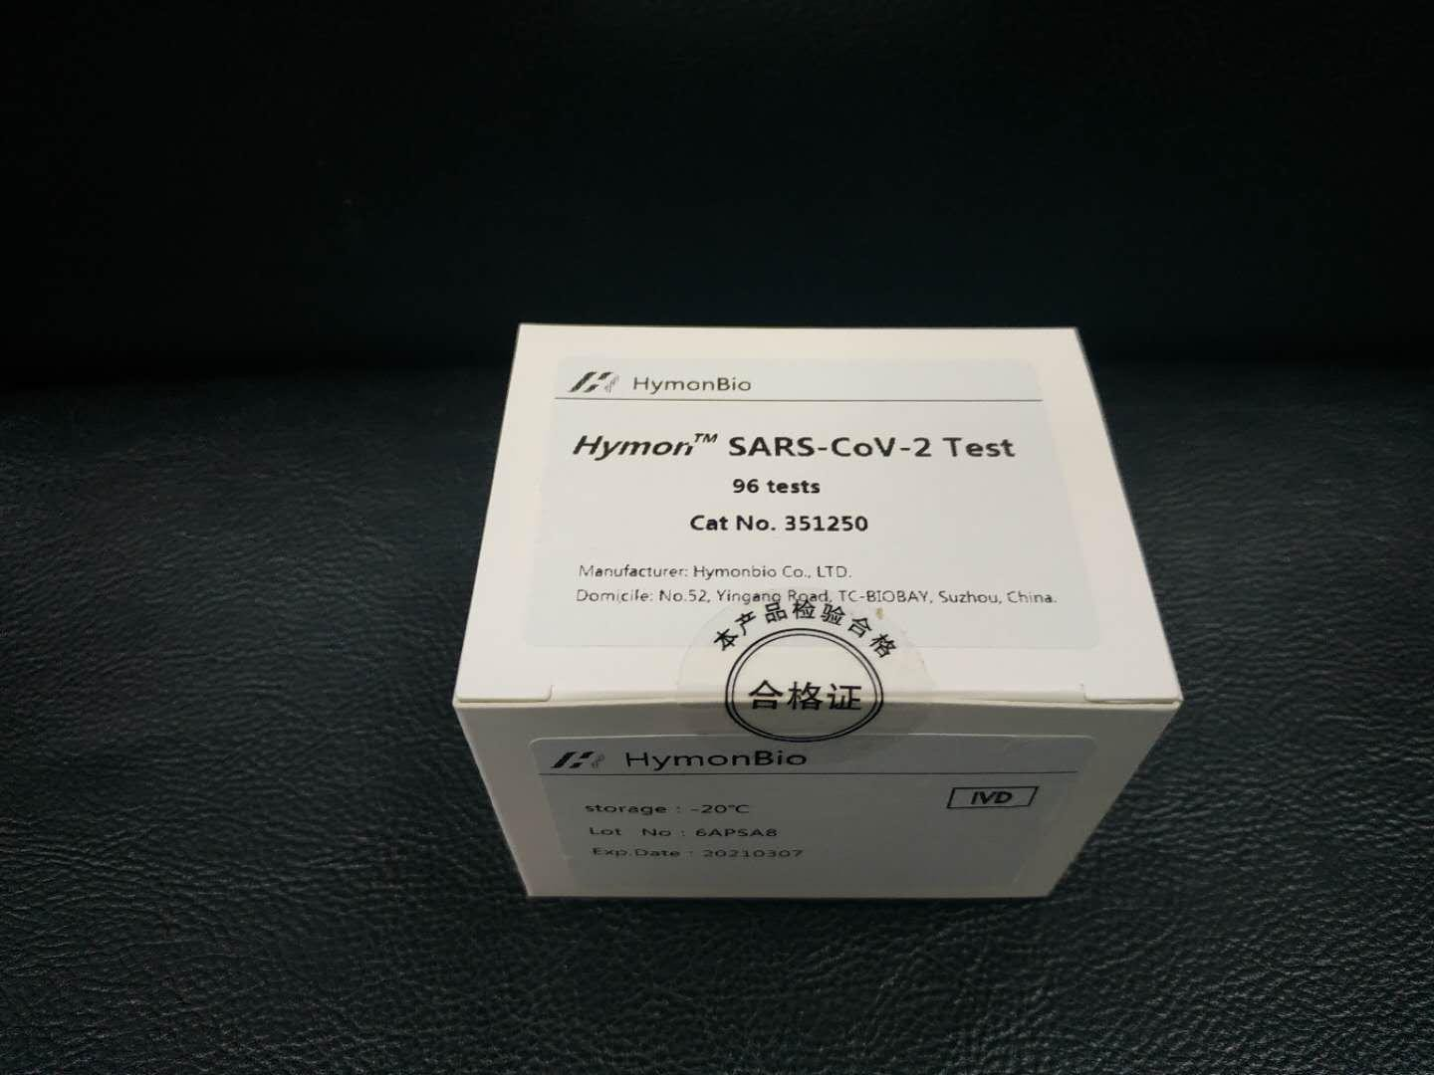
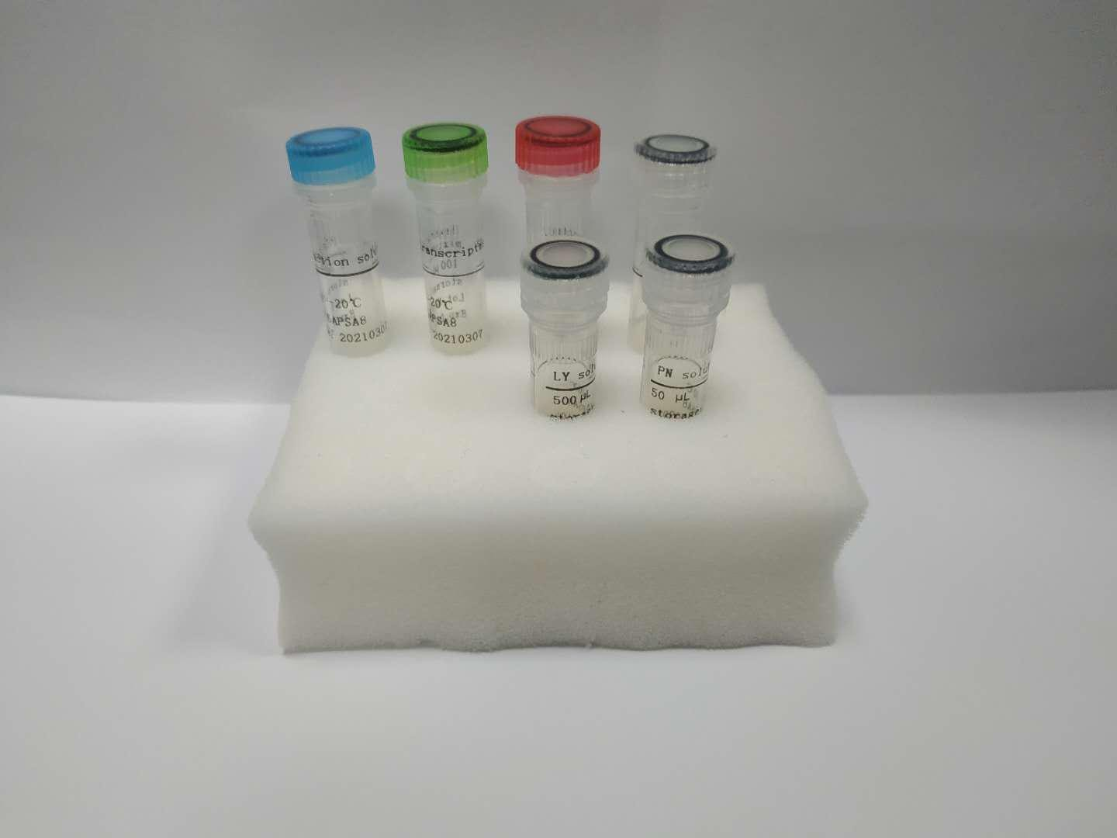
ⅡIntroduction of Hymon SARS-CoV-2 Test Kit
Ⅱ.ⅠDescription:
Hymon SARS-CoV-2 Test Kit provides in vitro detection of coronavirus SARS-CoV-2 in nasopharyngeal swab and other respiratory samples. The virus infects human and caused COVID-19.
The test applies proprietary MoLock, a nanobody-based probe technology, and OT, a buffer system technology, to build a fast and easy single-tube, sample-to-result ultrasensitive test. With overall turnaround time at 1.5 hours, the kit offers 5 copies/PCR detection limit of SARS-CoV-2. It provides references to key clinical decisions such as confirmation of early infection, evaluation of therapeutic efficacy, and determination of negative conversion.
Currently, HymonBio has manufactory capacity of 500,000 tests/week at its TC- Biobay base.

Slide 14
Ⅱ.Ⅱ Technological Features:
1.MoLock (Molecular Lock) for ultra-sensitivity and specificity, multiplexity:
LOD ≤ 5 copies/PCR
Specificity: zero cross-reactivity
Window period detection
MoLock, nanobody technology that stabilize primer hybridization on RNA and DNA improves initiation of reverse-transcription and elongation, boosting limit of detection to 5 copies/PCR, and zero cross-reactivity to other respiratory pathogens;
Multiplexed design and high sensitivity fit for screening of early-stage window- period infections;
2.DTDI (Dual-Targets-Dual-ICs) for robustness and quality:
False negative < 1/1000,000
Error rate: zero sampling or process error
Two PCR targets at viral N gene and E gene, reducing the risk of false negative to less than 1 millionth and resisting to mutations in viral strains after generations of infection;
One heterogeneous internal control for process quality, one house-keeping gene internal control for sampling quality;
3.One-Step Sample Processing for fast turnaround time of complete test:
TCT <1.5 hours
Sampling technology enables direct releasing of viral RNA for direct RT-PCR detection in 5 minutes without nucleic acid extraction.

Slide 15
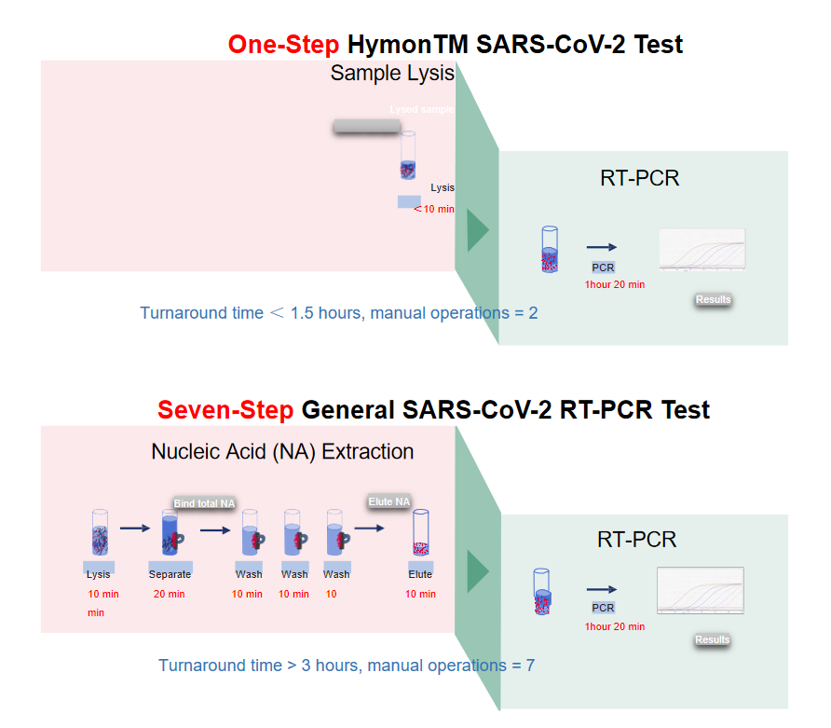
Ⅱ.Ⅲ Contrast:
1. HymonBio Single-Tube, Sample-to-Result RNA test：
One-step sample RNA processing
Direct RT-PCR with processed RNA，TAT<1.5 h
Early detection with viral LOD ≥ 5 copies/PCR
2. General SARS-CoV-2 RT-PCR Test：
≥ 6 steps for labor-intensive RNA processing Extracted RNA for RT-PCR with TAT>3 h

Slide 16
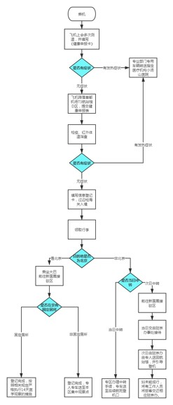
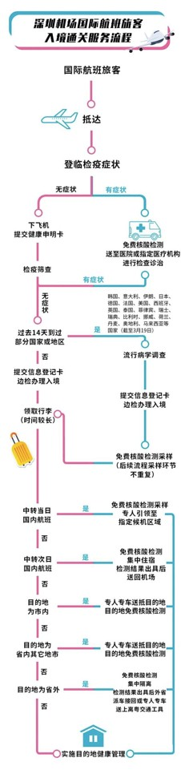
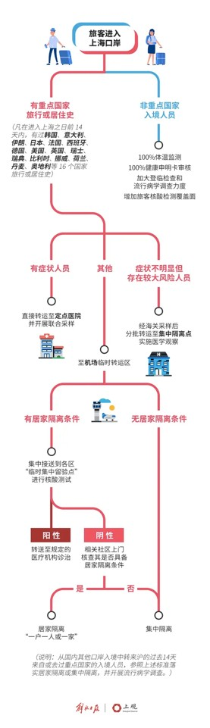
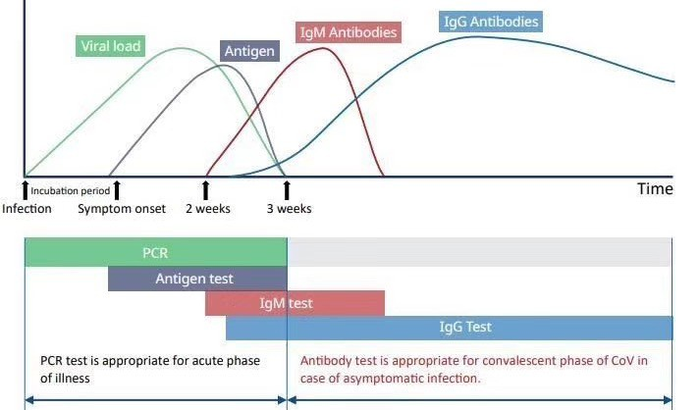
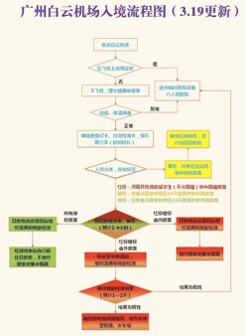
Ⅱ.Ⅳ RNA test is the only legitimate COVID-19 screening at entry ports
Hymon single-tube, sample-to-result SARS-CoV-2 Test Kit:
Detect virus in samples from respiratory tract Early detection with fast and ultrasensitive test Patient is contagious before virus into blood
Immuno-tests for COVID-19 i.e., IgG/IgM colloid gold tests :
Detect viral proteins or antibodies in blood Undetectable with early viral infection not in blood Only for diagnostic reference but screening

Slide 17
Ⅲ Hymon SARS-CoV-2 Test Kit Instruction for Use
Package Size/Cat.No.
96 tests/cat.no. 351250
Intended Use
The kit is made available for in vitro detection of nucleic acids of SARS-CoV-2.
The kit adopts RT-PCR method with real-time fluorescence. It can be used for laboratory detection of nucleic acids of SARS-CoV-2 in nasal swabs, pharyngeal swabs or other samples. The test results may serve as references to clinical evaluation of COVID-19.
Technical Principles
Based on real-time fluorescence PCR, the test targets SARS-COV-2’s N and E gene sequences as amplification target regions. Amplifying with specific primers and fluorescent probes, the test takes human genome sequence target as internal quality control.
Reagents
Item | Size | Amount | Contents
Nucleic acid detection reagent
PCR reaction solution | 1.3 mL | 1 tube | Primers & probes, dNTPs, MgCl2
Reverse transcriptase mixture | 100 μL | 1 tube | Reverse transcriptase, Taq DNA polymerase
Controls
Positive control | 25 μL | 1 tube | Synthetic RNA
Negative control | 900 μL | 1 tube | H2O

Slide 18
Note:
1.Nucleic acid extraction reagents are not included in the package and should be provided by users.
2.Negative control should participate in nucleic acid extraction as a sample.
3.Positive control does not participate in the extraction of nucleic acid and should be directly added into the PCR reaction solution.
Storage and Stability
Hymon SARS-CoV-2 Test Kit should be stored at -20℃ and the reagents are valid for 12 months.
Note: the specific production and expiry date of the product can be found on the kit label. Do not uses beyond the expiry date.
Instrument
Applied biosystems 7500/7300 Real-Time PCR System.
Sample Preparation
Nasal/pharyngeal swabs were collected according to clinical test requirements. Fresh samples collected can be used for test immediately or stored at -20±5℃ for no more than 3 months. Avoid repeated freezing and thawing.
Test Procedures
1. Nucleic acid extraction (sample preparation area)
It is recommended to take 200 μL liquid sample for nucleic acid extraction. Recommended nucleic acid extraction kit includes Hymon Nucleic Acid Kit(cat.no. 341312) by Hymonbio Co., LTD and other commercial products. Please follow the instructions of the kit.
The negative control in this kit participates in the extraction and is used to monitor the process; the positive control does not participate in the extraction and is used for the quality control of PCR detection reagents.
2.PCR reagent preparation (at reagent preparation area)

Slide 19
2.1 Take the PCR reaction solution out of the kit, melt at room temperature, vertex and mix well, and flush spin to settle down contents to bottom of tube .
Take N (N = Number of test samples + 2) PCR reaction tubes. The amplification system is prepared as follows:
Reagent | PCR reaction solution | Reverse transcriptase mixture
Volume | 13 μL × N | 1 μL × N
2.2 Flush spin after the components are fully mixed, so that all the contents is settled down to the bottom of the tube. Add 14 μL prepared PCR reaction solution into each PCR tubes.
3. Sample loading (sample preparation area)
Add each 6μL of the processed negative control, the nucleic acid of the sample to be tested and the positive control into the PCR reaction tubes successively, cover the tubes tight, mix the tubes thoroughly, and transfer PCR reaction tubes to the amplification detection area after flush spin.
4. PCR amplification (amplification detection area)
4.1 Put the reaction tubes into the sample tank of the instrument.
4.2 ABI instrument settings (take ABI 7500 as an example)
4.2.1 Open the "setup" window, set Negative control (NC), Positive control (PC), Unknown samples (Unknown) according to the corresponding order of samples, and set the sample names in the "Sample Name" column.

Slide 20
4.2.2 Open the "instrument" window and set the cycle conditions as follows:
42℃, 5 min;
94℃, 1 min;
95℃ 15 sec,60℃ 31 sec,72℃ 30 sec; the fluorescence signal is collected at 60 ℃, and the signal collection channels are FAM and VIC,40 cycles.
After setting, save the file and run the program.
5.Result analysis
Automatically save the result after the reaction, and adjust the start value, end value and threshold value of baseline according to the image after analysis (Users can adjust the value according to the actual situation. The start value can be set at 3~15, the end value can be set at 5~20 and the threshold value can be set at the Log spectrum window. The threshold lines shall be in the index period of the amplification curve. The amplification curve of the negative control is straight or lower than the threshold line).
Click "analysis" to obtain the analysis results automatically, and read the test results in the "report" window.
Quality Control
Negative control: there is no obvious amplification curve of FAM and VIC;
Positive control: there is obvious amplification curve of FAM and VIC, Ct value ≤ 30;
The above requirements shall be met simultaneously in the same experiment, otherwise, the experiments are invalid and need to be repeated.

Slide 21
Result Interpretation
Detection results |  | Result | Result interpretation
FAM Ct value | VIC Ct value
No result or Ct > 38 | Ct ≤ 38 | SARS-CoV-2negative | It indicates that there is no RNA of SARS-CoV-2in the tested sample or its concentration is lower than the limit of detection with the kit
No result or Ct > 38 | Ct > 38 | Need reexamination | The result is not valid. The cause shall be found out and eliminated, and the sample shall be rechecked.
Ct ≤ 38 | Ct ≤ 38 or Ct > 38 | SARS-CoV-2positive | Indicates that the tested sample contains RNA of SARS-CoV-2
Limitations of Tests
The test results of samples are related to the collection, transportation, treatment and preservation of samples. If any of the above links are improperly operated, it may lead to false negative or false positive results of the test.

Slide 22
Product Performance Index
Analytical sensitivity: 5 copies/reaction.
There is no cross reaction with other pathogens such as influenza A virus, influenza B virus, parainfluenza virus, respiratory syncytial virus, adenovirus, dengue virus, SARS, MERS-CoV, OC43, NL63, 229E and HKU1.
Precautions
1.All samples shall be considered as potentially infectious and shall be operated and handled in strict accordance with the laboratory's biosafety requirements. The experimental personnel should receive professional training (Including sample processing, reagent preparation, instrument operation and software setting, etc.). For the laboratory management specifications, please strictly follow the relevant management specifications for gene amplification test laboratory issued by local regulatory agencies.
2.This kit is only used for in vitro detection.
3.The laboratory should be separated by reagent preparation area, sample preparation area and amplification detection area. Work flow: all the articles in each area are for special purpose, and they shall not be used in a cross way to avoid contamination. Laboratory clothes, hats, shoes, gloves, etc. shall be fully equiped during operation to avoid direct contact of reagents or samples with skin. In case of liquid leakage, wash with plenty of water immediately. In case of contact with skin wound, inform local health and epidemic prevention department in time.

Slide 23
4. The real-time fluorescent quantitative PCR analyzer should be calibrated regularly.
5. Please put the used pipette tips into the waste tank directly, and discard them in a designated manner at a designated place together with other discarded articles according to local regulations.
6. Clean the working area immediately after the experiment. The bench and all kinds of experimental articles should be disinfected with 1% sodium hypochlorite, 75% alcohol or UV light regularly.
Basic Information Manufacturer: Hymonbio Co., LTD. Domicile: No.52, Yingang Road, TC-BIOBAY, Suzhou, China. Postal code: 215434 Production address: 3 / F, building 4, TC-BIOBAY, Suzhou, China. Date of approval and amendment of the specification: February 18, 2020

Slide 24
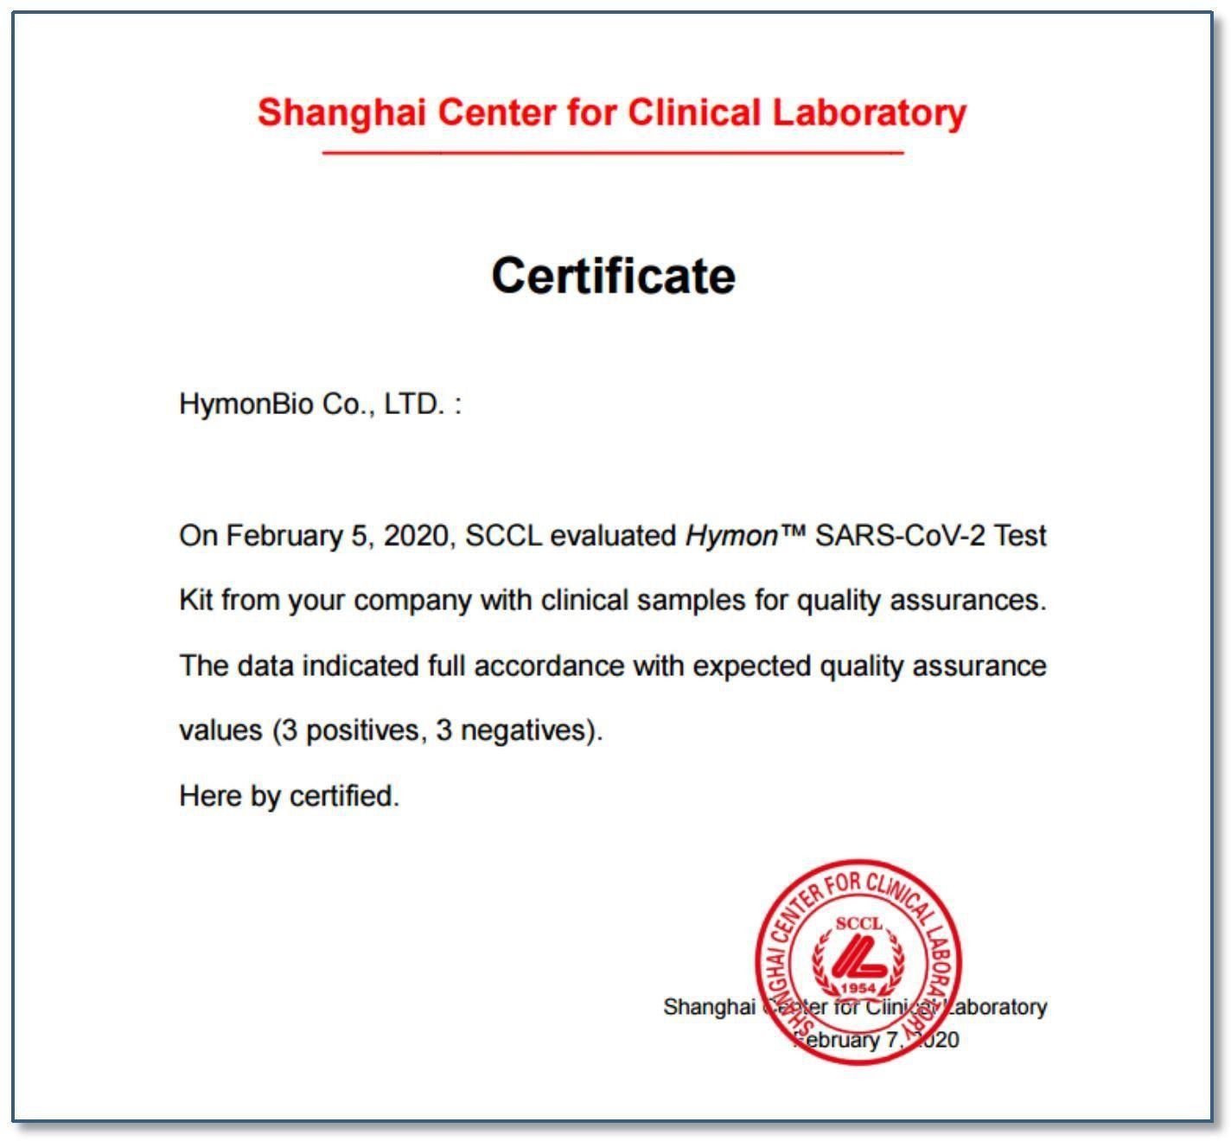
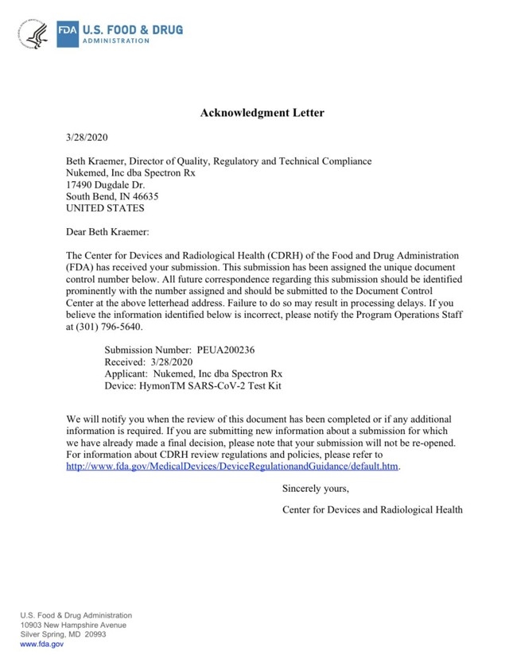
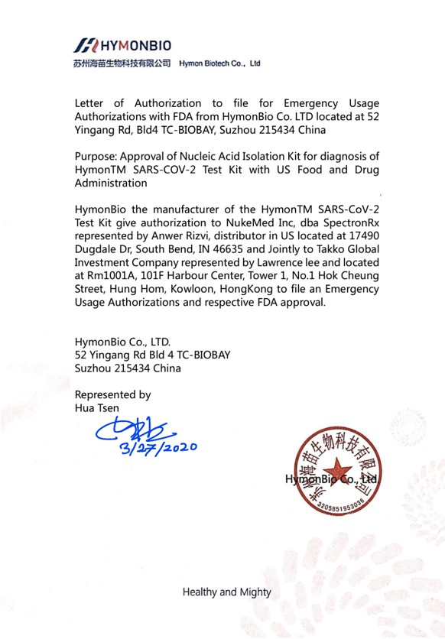
* Official Certificate by Shanghai Center for Clinical Laboratory
* FDA acknowledged HymonTM SARS-CoV-2 Test Kit in EUA process on 3/28/2020

Slide 25
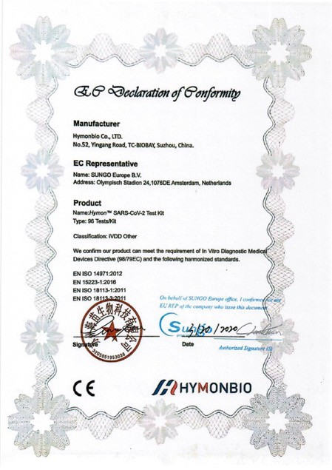
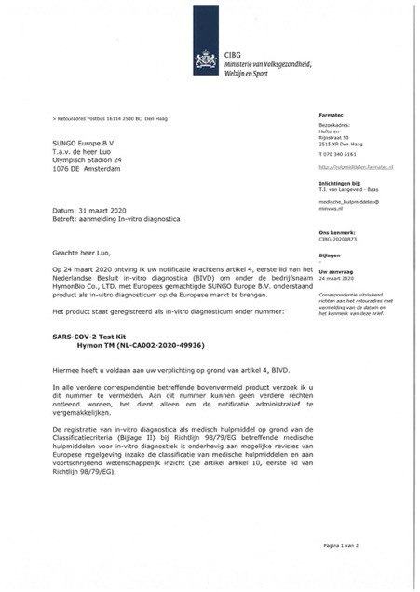
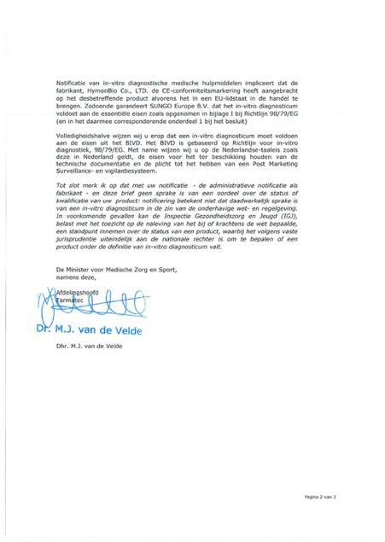
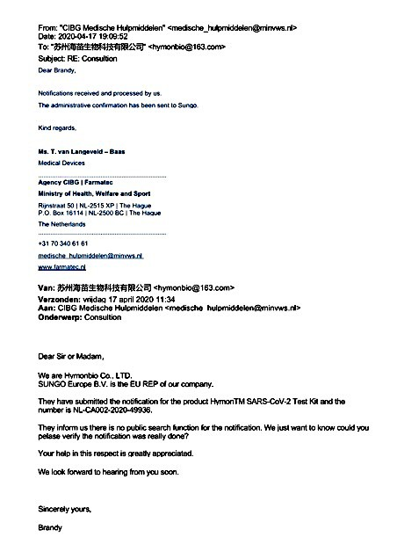
* Certificate – CE CONFORMITY Declaration & ISO13485

Slide 26
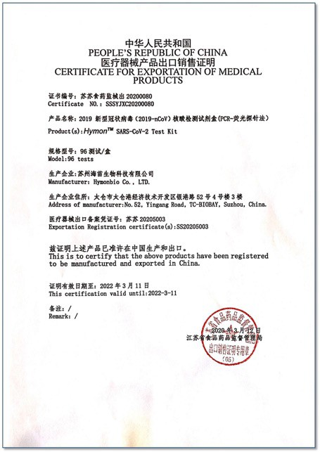
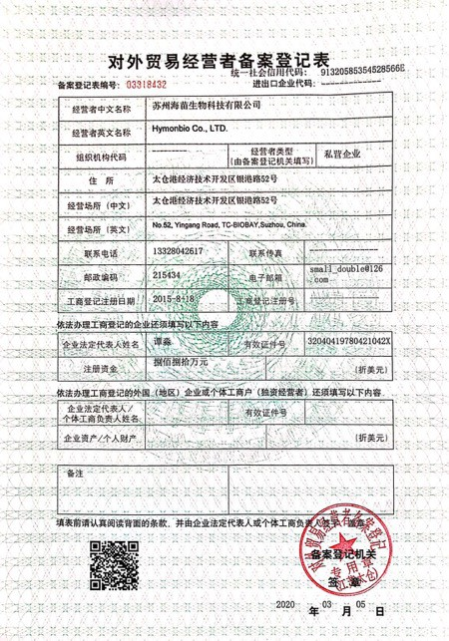
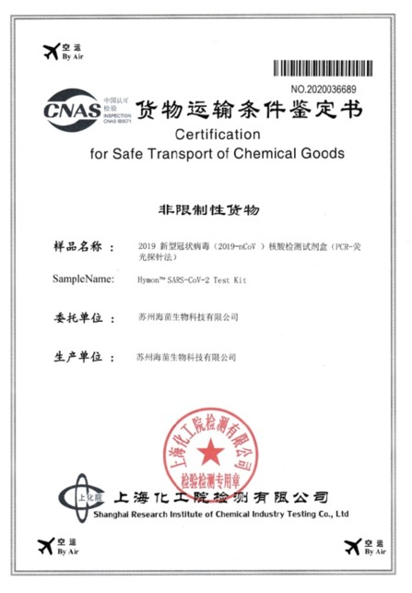
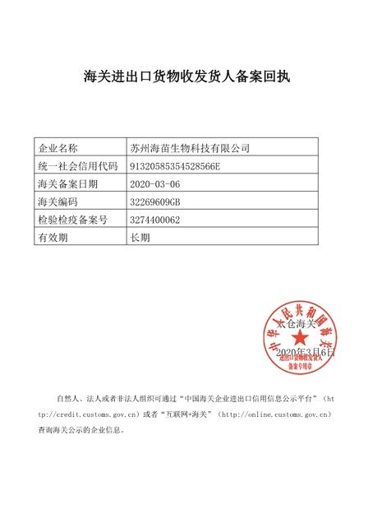
* Export License by CFDA and Foreign Trade License

Slide 27
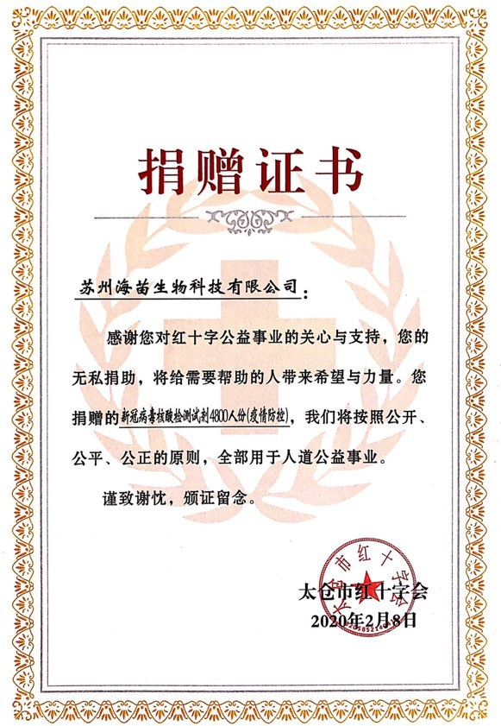
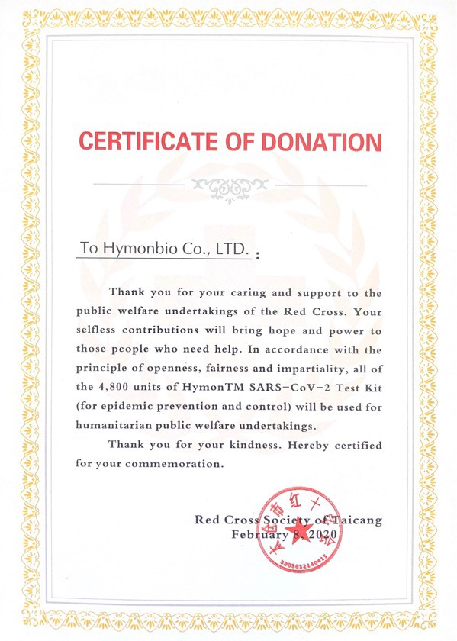
* Certificate – Donation Commemoration from Red Cross

Slide 28
Contact Information:
Company Name: Shenzhen Polyhex Technology Company Limited
Address: 5-6/F., East Zone, Shunheda A2 Building, Liuxiandong Industrial Park, Xili, Nanshan Dist., Shenzhen, 518055 China
Phone Number: +86 755 85269856
Mailbox: alex@polyhex.net
Website: http://www.polyhex.net/
http://www.polyhex.net/news.html?id=72

